Slide 1
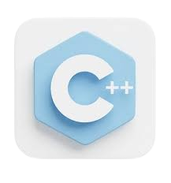

Lecture 2 – Fundamentals - 1
Programming Fundamentals with C++
Dr. Muhammad Sajjad
R.A Asad Ullah

Slide 2

Overview
Variables
Definition
Purpose
Rules for writing Variables Names
Data Types in C++
Purpose of Data Types
Pre-Defined Data Types in C++
Declaration & Initialization of Variables
Declaration
Initialization
Default Value

Slide 3
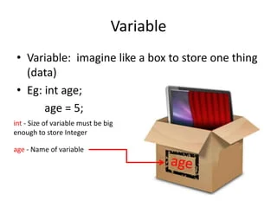
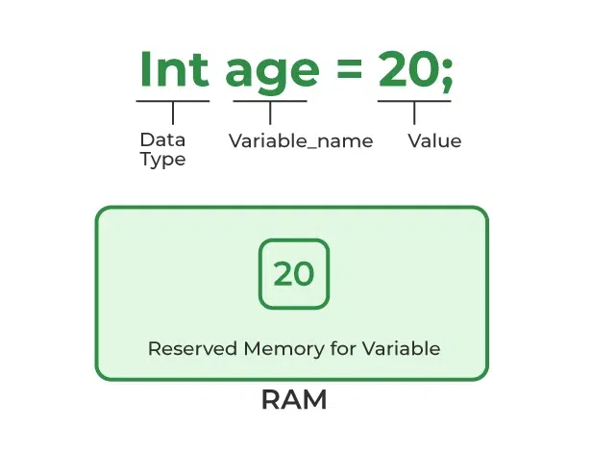
Variables
Definition
Variables are like storage containers in a program where you can save data.
Think of a variable as a labeled box where you can store and retrieve information.
For example, if you want to store a person’s age, you might create a variable called age.
Purpose
Variables allow us to save values temporarily, making it possible to reuse data and perform operations throughout a program.

Slide 4
Variables
Rules for writing Variables Names
The first character of variable name must be an alphabetic character.
Underscore can be used as first character of variable name.
Blank spaces are not allowed in a variable name.
Special character, such as arithmetic operators, #, ^, etc. cannot be used in a variable name.
Reserved words (keywords) cannot be used as variable names.
The maximum length of a variable name depends upon the compiler of C++.
A variable name declared for one data type cannot be used to declare another data type.
Note
C++ is a case-sensitive language. Thus variable names with same spellings but different cases are treated as different variables names.
For example, variables “Pay” and “pay” are two different variables.

Slide 5
Variables
Following are some examples of the valid and invalid variable names.
Variable Name | Valid / Invalid | Remarks
Nadeem | valid
perform | valid
double | invalid | C++ reserved word
foxpro | valid
switch | invalid | C++ reserved word
Marrie | valid
int | invalid | C++ reserved word
3rd | invalid | Start with a numeral
unsigned | invalid | C++ reserved word
x-y | invalid | Special character used
Taq Ahd | invalid | Spaces not allowed

Slide 6
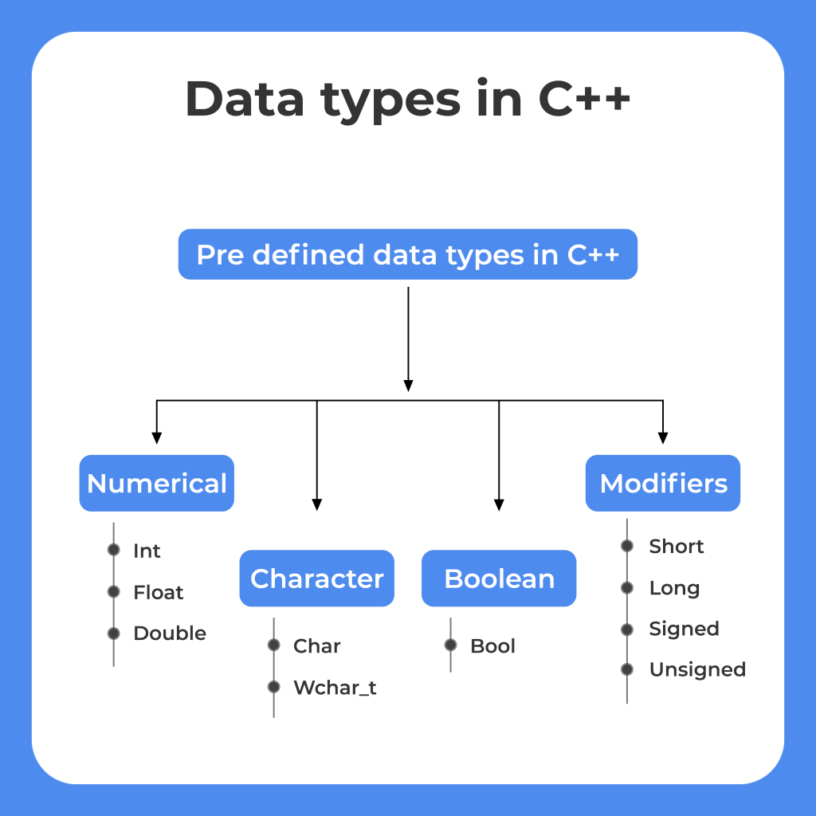
Data Types in C++
Purpose of Data Types
Data types specify the kind of data a variable can hold.
This is important because different types of data (like whole numbers, decimal numbers, characters) are handled differently by the computer.
Pre-Defined Data Types in C++
int: Used for integer numbers (e.g., int age = 20;).
float and double: Used for numbers with decimals. float has lower precision compared to double. Example: float price = 19.99;
char: Stores a single character, like a letter or symbol. Example: char grade = 'A';
bool: Stores a boolean value, which can be either true or false.
Example: bool is_student = true;

Slide 7
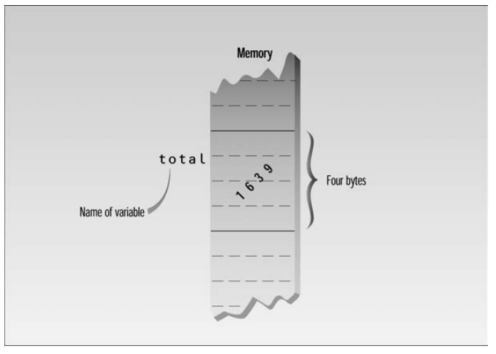
Data Types in C++
The int Data Type
Definition: int is short for "integer," representing whole numbers (both positive and negative) without any decimal point.
Usage: It is used to store values like counts, ages, IDs, etc.
Memory: The amount of memory occupied by the integer types is system dependent. On a 32-bit system such as Windows, an int occupies 4 bytes (which is 32 bits) of memory, allowing a range of about -2 billion to 2 billion (-2,147,483,648 to 2,147,483,647).
Example
int total = 1639;

Slide 8
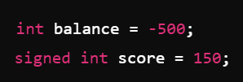

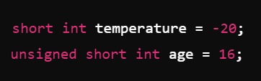

Data Types in C++
The int Data Type
Qualifiers
C++ provides several qualifiers that can be used with int to modify its properties, mainly to control size and sign.
signed int
Description: The default int type is signed, meaning it can store both positive and negative values.
Range: Typically, from -2,147,483,648 to 2,147,483,647.
unsigned int
Description: An unsigned int can only store non-negative values, effectively doubling the maximum positive range.
Range: 0 to 4,294,967,295 (for 4 bytes).
short int
Description: A short int uses less memory, usually 2 bytes (16 bits), which means a smaller range.
Range: -32,768 to 32,767 for signed and 0 to 65,535 for unsigned.
Long int
Description: A long int allows for a larger range of values, typically using 8 bytes (64 bits) on most systems.
Range: -9,223,372,036,854,775,808 to 9,223,372,036,854,775,807 for signed and 0 to 18,446,744,073,709,551,615 for unsigned.

Slide 9
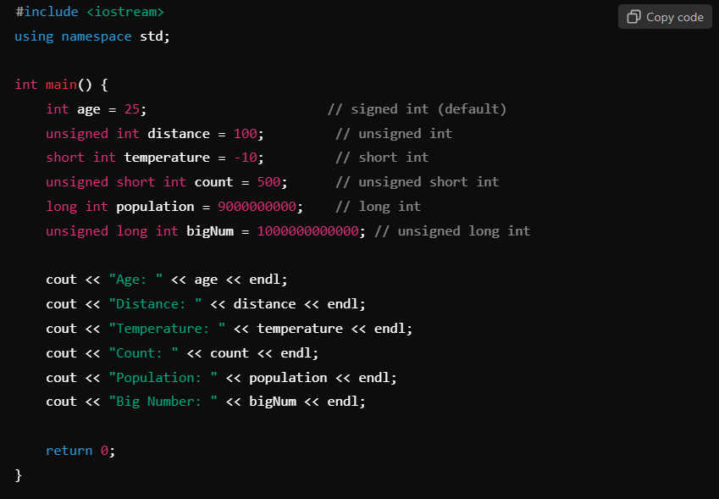
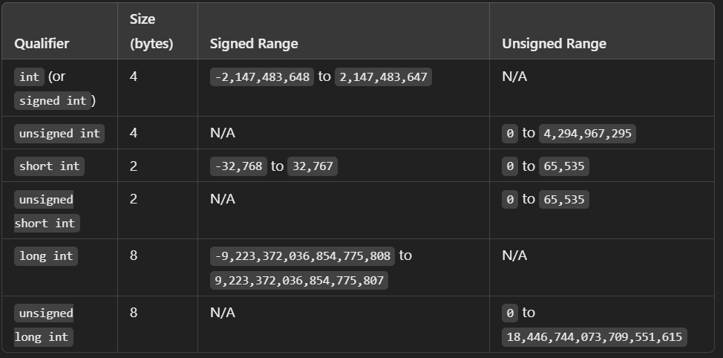
Data Types in C++
The int Data Type
Summary and Example Code
Summary
Code

Slide 10
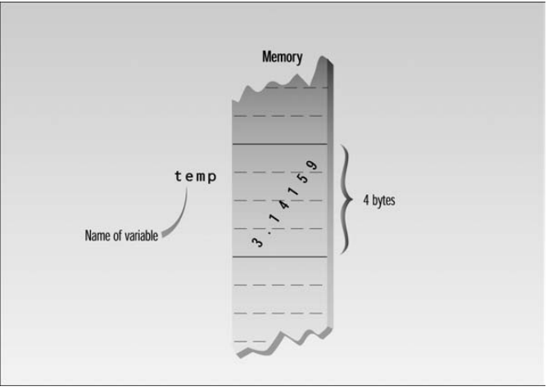
Data Types in C++
The float Data Type
Definition: float is a data type used to store single-precision floating-point numbers, which are numbers with a decimal point.
Usage: Ideal for storing real numbers in applications where high precision is not essential, such as graphical or scientific applications.
Memory: Typically, a float uses 4 bytes (32 bits), providing a range of approximately ±3.4 x 10^38 and a precision of 6-7 decimal places.
Example
float temp = 3.14159;

Slide 11


Data Types in C++
The float Data Type
Qualifiers
In addition to float, C++ offers other floating-point types to handle different levels of precision and range.
float
Description: Single-precision floating-point, typically 4 bytes.
Precision: ~6-7 decimal digits.
double
Description: Double-precision floating-point, generally using 8 bytes.
Precision: ~15-16 decimal digits.
long double
Description: Extended-precision floating-point, size can vary (often 10-16 bytes depending on the compiler).
Precision: More precise than double, often up to 18-19 decimal digits.

Slide 12
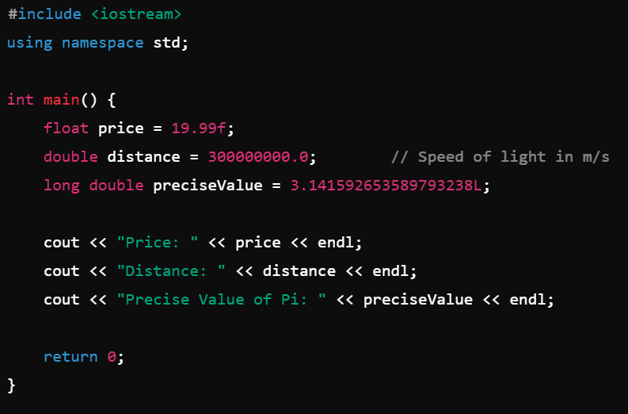
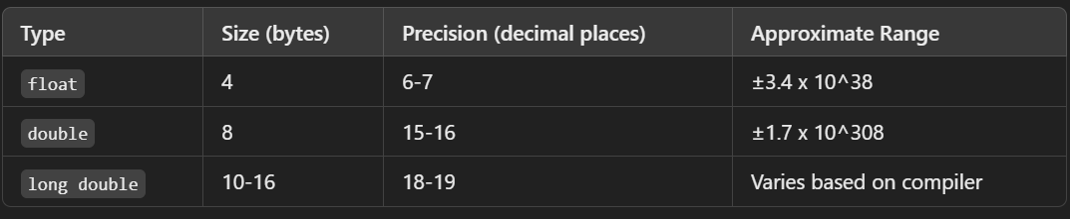
Data Types in C++
The float Data Type
Summary and Example Code
Summary
Code
Note: The suffix f is used to specify float, and L for long double to avoid any ambiguity with the compiler.

Slide 13
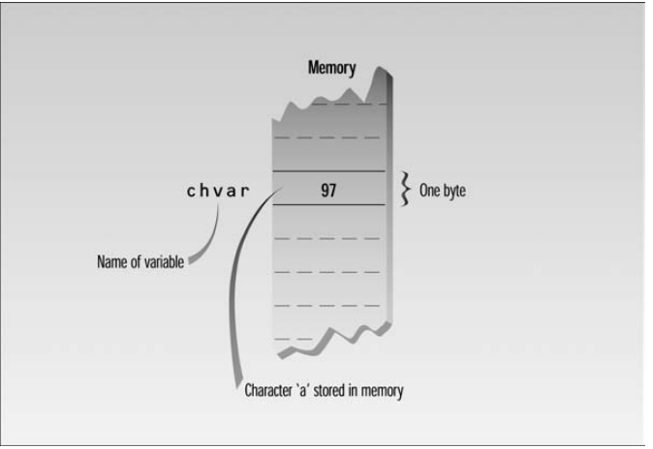
Data Types in C++
The char Data Type
Definition: char is a data type used to store individual characters (letters, numbers, symbols).
Usage: Commonly used to store single characters like 'A', 'b', '3', or symbols like '$'.
Memory: Typically uses 1 byte (8 bits), enough to store 256 different values (for ASCII characters).
Range: char can store values from -128 to 127 if it’s signed, and 0 to 255 if it’s unsigned.
ASCII Representation: Each char variable holds an integer value corresponding to the ASCII code of the character.
Example
char a = 97; // 97 is ASCII for ‘a’
Or char a = ‘a’;
Note: Strictly speaking type char is an integer type as well

Slide 14
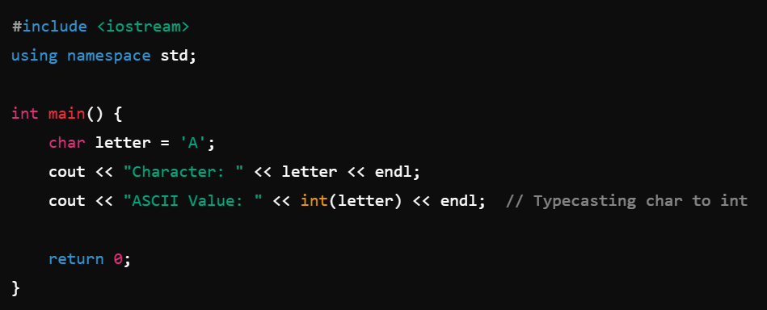
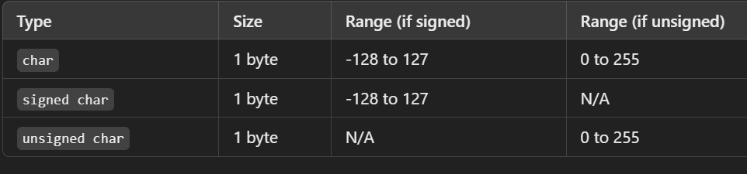
Data Types in C++
The char Data Type
Qualifiers
Signed char: Can hold values from -128 to 127, allowing negative values, which are sometimes used to represent extended ASCII characters.
Unsigned char: Ranges from 0 to 255, which is useful if you only need positive values (standard ASCII values).
Output:
Character : A
ASCII Value: 65

Slide 15
Data Types in C++
memory
The bool Data Type
Definition: bool is a data type used to represent Boolean values: true and false.
Purpose: Primarily used in conditional statements and logic operations to control the flow of the program.
Memory: Generally uses 1 byte* of memory, although the exact size can vary depending on the compiler.
Boolean Values: In C++, bool variables can have only two values i.e. true(1) or false (0).
Example
bool is_raining = true;
1
is_raining
1 byte
Name of
variable
Notes:
*In theory a bool type requires only one bit (not byte) of storage, but in practice compilers often store them as bytes because a byte can be quickly accessed, while an individual bit must be extracted from a byte, which requires additional time.

Slide 16
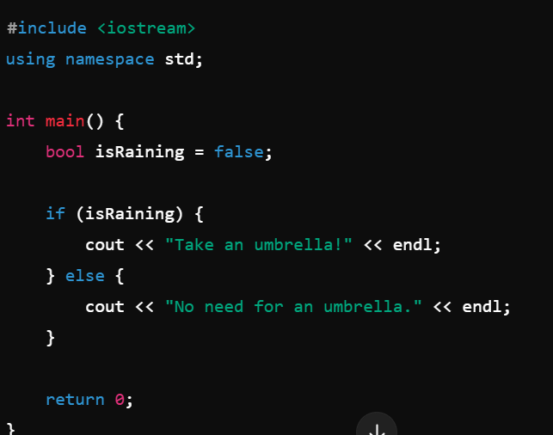
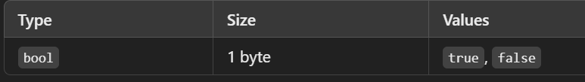
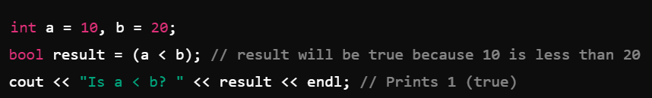
Data Types in C++
The bool Data Type
Summary and Example Code
Summary
Using bool in comparison
Using bool in condition

Slide 17
Declaration & Initialization of Variables
Declaration
Declaring a variable means informing the compiler about the variable’s name and type, reserving space in memory for it.
Example: int age; — Here, int specifies the data type (integer), and age is the variable name.
When a variable is declared, its memory is allocated, but it doesn't necessarily contain a meaningful value until it is initialized.
Initialization
Initialization occurs when you assign a value to a variable at the time of its declaration.
Example: int age = 20; — This both declares age as an int and initializes it with the value 20.
Initializing variables ensures they have a known starting value, avoiding potential bugs caused by “garbage values” (random values in memory).
Declaration Examples:
int age;
float salary, bonus;
Char grade;
bool isOpen;
Initializing:
age = 18;
salary = 2000000;
bonus = 10000;
grade = ‘A’;
isOpen = false;
Declaring & Initializing at same time:
int age = 22;
char grade = ‘B’
Default Value : int a;
cout<<a;
output: Some random value

Slide 18
Thank You

